Slide 1
Review of previous classes
Nano in Histroy
The Localized Surface Plasmon Resonance
DICHROISM
Development of nanoscience and technology
Diversity of nano field
Surface to volume atoms of Cuboctahedral system
M(K) = (1/3)*(10K³+15K²+11K+3), K = No. of shell
N_{K} =10K² + 2, Every shell contains number of shell
1. Nanotechnology in upward motion: next future of science and technology is nanotechnology
2. Constructive - Destructive interference by thin films
3. Non-Reflective Surfaces
4. Super-Hydro-Phobicity
5. Self-Cleaning
SIZE EFFECT
Quantum Effect
Colour, Melting point, Specific heat, Electrical, Magnetic properties etc.
To-Down Method of Preparation
Ball mill, Thermal, Arc discharge, Laser ablation etc. Lithography
Bottom – up preparation method
Characterisation: AFM, STM, TEM, SEM, IR, Raman, BET, DLS etc.
Carbon Nanotube
Curvature
Properties

Slide 2
SURFACE CURVATURE
Surface curvature has important role to define the properties of materials
CLASS OF MATERIALS
Metallic materials
Ceramic materials: (ionic in nature or co-valent or mixture)
They have very good corrosion resistance properties
(c) Polymer materials
Natural: Proteins enzymes etc.
Good insulators and have good corrosion resistance
(d) Composite materials
One act as matrix and other act as reinforcement phase
(e) Electronic materials (it is very broad (metal, semiconductor and insulator)
(f) Magnetic materials
(g) Biomaterials
(h) Nanomaterials (0-d, 1-d, 2-d and 3-D)

Slide 3
INTERNAL STRUCTURE
ATOMIC STRUCTURE
ATOMIC BONDING
IONIC, CO-VALENT, VANDERWALL, METALLIC
Net force is zero F_{N}=F_{r}+F_{a}=0
CRYSTAL STRUCTURE
ALLOTROPIC TRANSFORMATINS
Fe: BCC at room temperature
FCC at 750⁰C
FCC at 125Kbar at room temperature
MOLECULAR STRUCTURE
Polymer

Slide 4
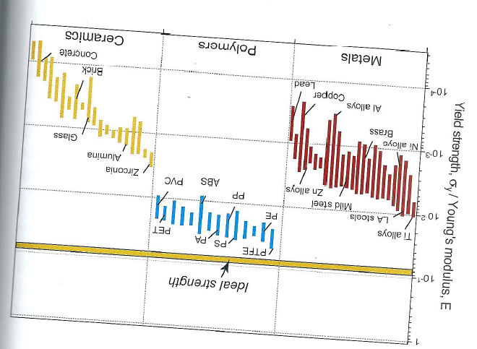
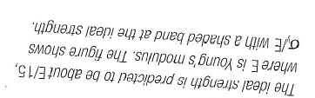
DEFECTS
Point Defects (Scottkey defects, Frenkel defects)
Linear Defects (Edge dislocations)
Planer Defects (Interfacial defects, Grain boundary, Interphase boundary)
Volume defects
Casting defects (Cavities and gas holes)
MECHANICAL BEHAVIOUR

Slide 5
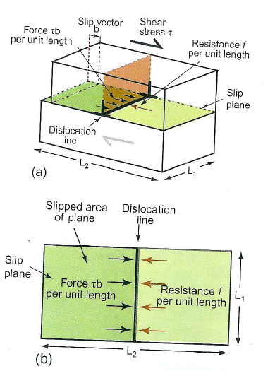
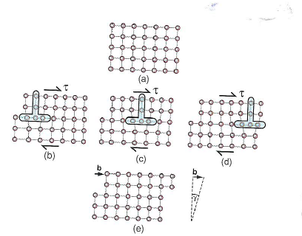
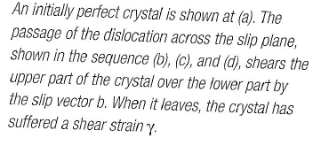


Slide 6
Size Effect
• Delocalization of the valency electron (Discrete energy level)
• Structure also changes with size.
• The above two changes can lead to different physical and chemical
properties, depending on size
Optical properties
Bandgap
Melting point
Specific heat
Surface reactivity
Magnetic property
Electrical conduction,
Sterical,
Biological So on…..

Slide 7
Specific heat
• C = ∆Q/m∆T; the amount of heat ∆Q required to raise the temperature by ∆T of a sample of mass m
• Specific heat of polycrystalline materials given by Dulong-Petit law (1819) - > Specific heat of a crystal is due to lattice vibration -> 3RM ⁻¹(R is gas constant and M is the molar mass)
It fails at low temperature, Debye model - > Particle in a box principle to Phonons (i.e. Phonon in a box)
c_{s} velocity of sound
• C_{v} of nanocrystalline materials are higher than their bulk counterparts. Example:
- Pd: 48% ↑ from 25 to 37 J/mol.K at 250 K for 6 nm crystalline
- Cu: 8.3% ↑ from 24 to 26 J/mol.K at 250 K for 8 nm
- Ru: 22% ↑ from 23 to 28 J/mol.K at 250 K for 6 nm

Slide 8
Melting point of nanocrystalline mterials
∆θ = Deviation of melting point from the bulk value
T_{o} = Bulk melting point
σ = Surface tension coefficient for a liquid-solid interface
ρ = Particle density
r = Particle radius
L = Latent heat of fusion

Slide 9
• Lowering of the melting point is proportional to 1/r
• Δθ can be as large as couple of hundred degrees when the particle size gets below 10 nm!
Note: For nanoparticles embedded in a matrix, melting point may be lower or higher, depending on the strength of the interaction between the particle and matrix.

Slide 10
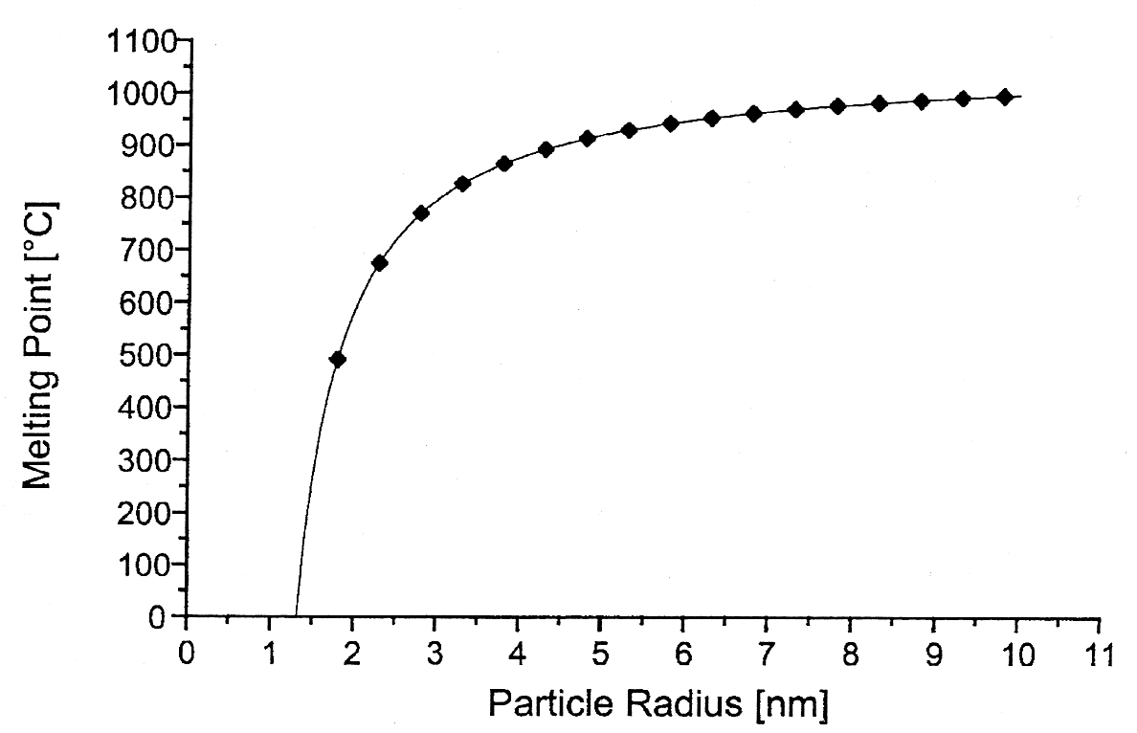
The melting point of gold particles decreases dramatically as the particle size gets below 5 nm
Source: Nanoscale Materials in Chemistry, Wiley, 2001

Slide 11
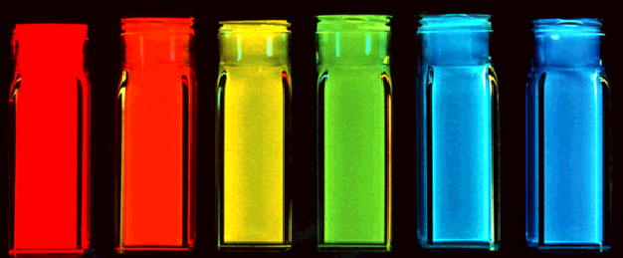
Optical properties of Nanomaterials
Ordinary light excites all color quantum dots.
(Any light source “bluer” than the dot of interest works.)
Quantum dots change color with size because additional
energy is required to “confine” the semiconductor
excitation to a smaller volume.

Slide 12
Electrical Conductivity
• For metals, conductivity is based on their band structure.
µ_{e} =mobility, m_{e} = effective mass of electron, ν_{F} =Fermi velocity of the electron, λ =meen free path
Scattering mechanisms
(1) By lattice defects (foreign atoms, vacancies, interstitial positions, grain boundaries, dislocations, stacking disorders)
more or less independent of temperature
(2) Scattering at thermal vibration of the lattice (phonons)
independent of lattice defects, but dependent on temperature
Electric current collective motion of electrons; in a bulk metal,
Ohm’s law: V = RI, If a bias voltage is applied to the quantum dot (V=e/C), a tunneling current I_{t} is produced:
Band structure begins to change when metal particles become small. Discrete energy levels begin to dominate, and Ohm’s law is no longer valid.
Increase in ceramic and magnetic nanomaterials but Decrease in metals

Slide 13
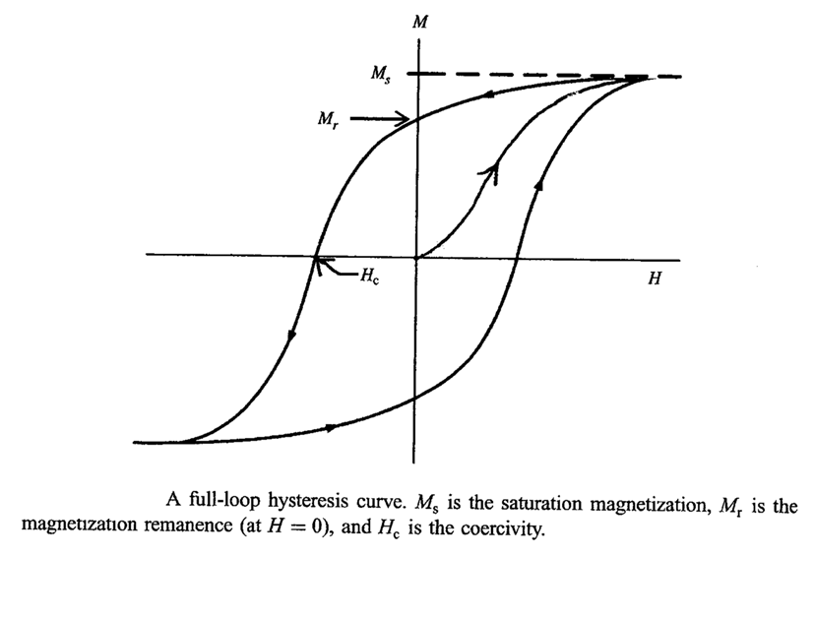
HYSTERESIS
HARD MAGNETS - H_{c} > 100 Oe (MOTORS, GENERATORS),
SOFT MAGENTS - H_{c} < 10 Oe (TRANSFORMER CORES, ELECTRONIC CIRCUITS)

Slide 14
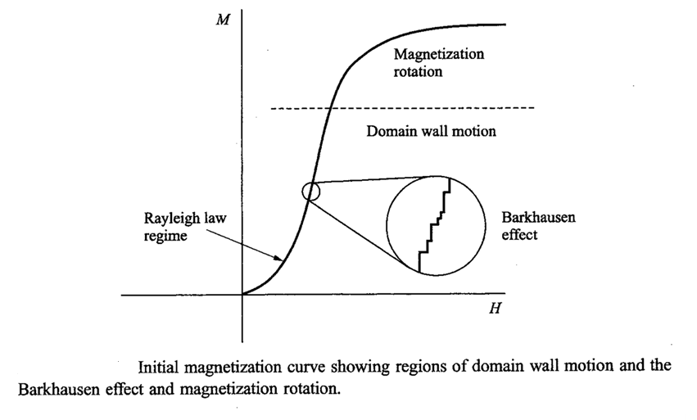
The initial magnetization curve may be divided into two regimes:
(i) Rayleigh law regime and (ii) Magnetization rotation
The low-field behavior of the initial magnetization is given by the Rayleigh law,
µ = µ_{o} + nH (B = µH)
where µ_{o} and n are the Rayleigh constants of the material:
30 < µ_{o} < 10⁵ , 0.5 < n < 1.2 x 10⁷ and B = µ_{o}H + nH²
Hence the parabolic nature of M vs. H at low H.

Slide 15
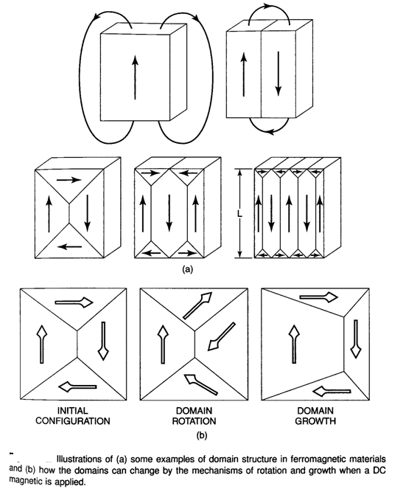
MAGNETIC DOMAINS
An ordinary piece of iron below its curie temperature shows spontaneous magnetization called micromagnetics.
A macroscopic magnetic material will break up into magnetic domains to minimize the energy.

Slide 16
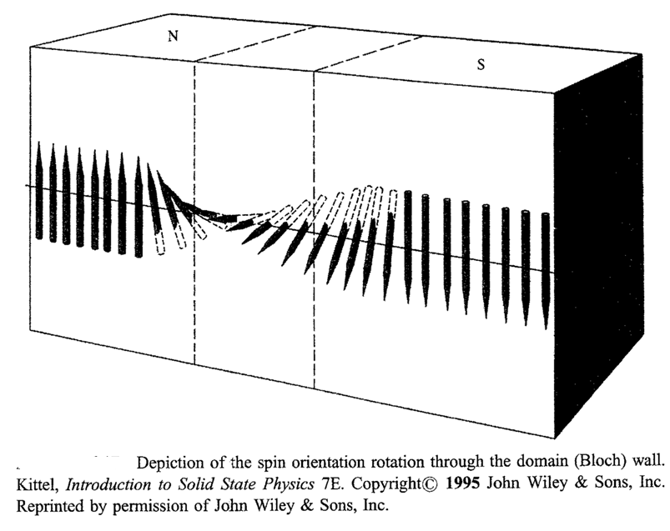

Slide 17
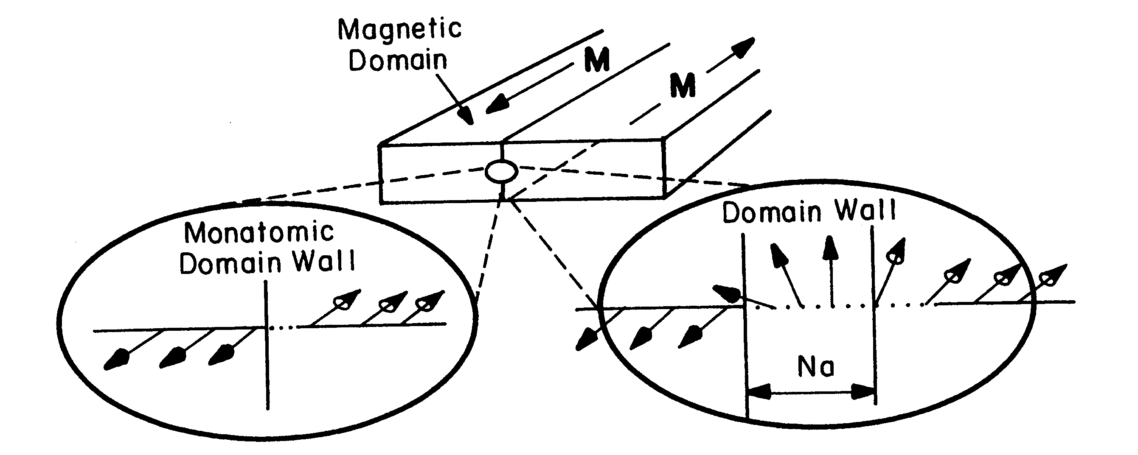
Schematic of ferromagnetic material containing a 180º domain wall (center). Left, hypothetical wall structure if spins reverse direction over one atomic distance. Right for over N atomic distance, a. In real materials, N: 40 to 10⁴.

Slide 18
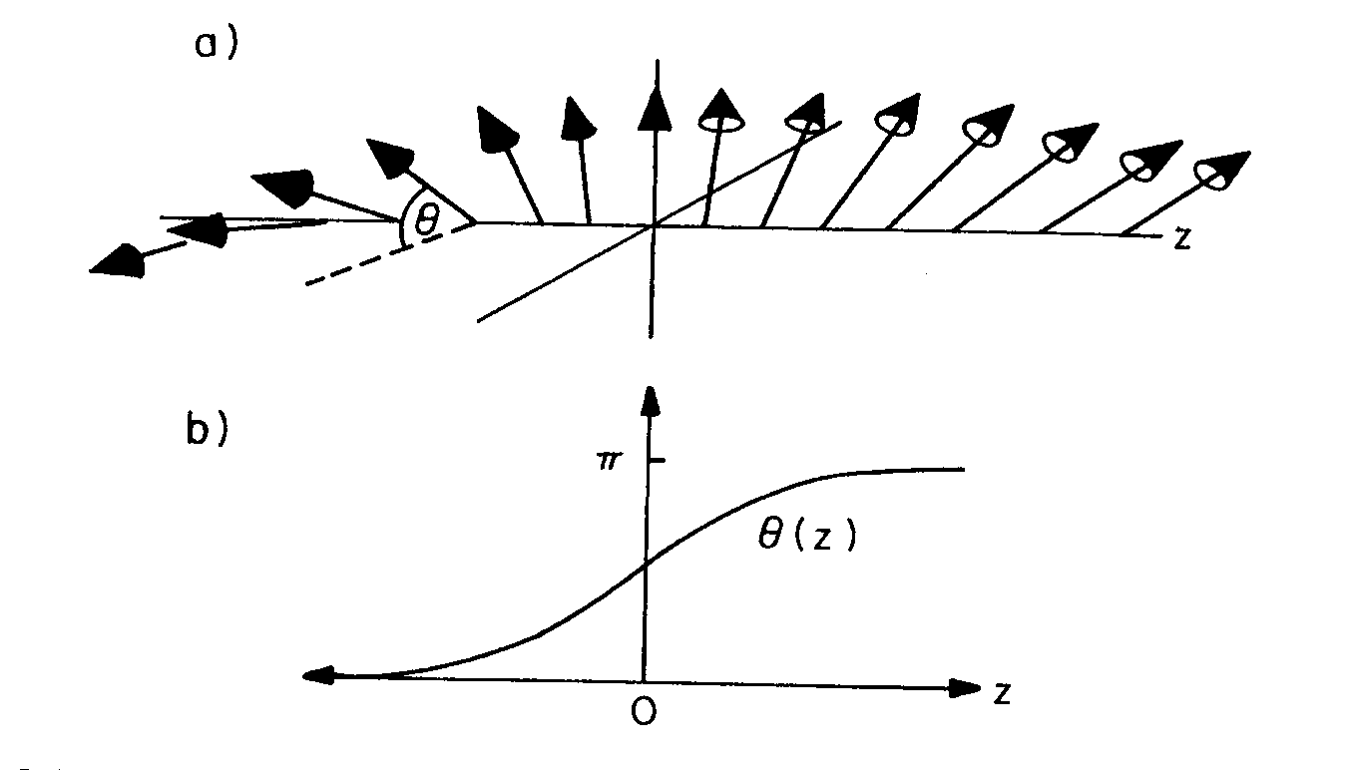
magnified sketch of the spin orientation within
a 180º Bloch wall in a uniaxial materials; (b) an appro-
ximation of the variation of θ with distance z through
the wall.

Slide 19
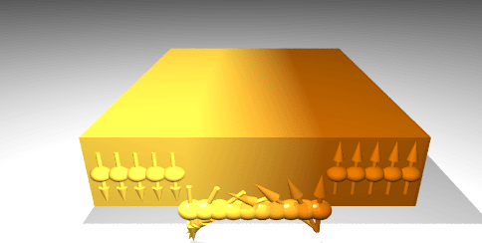
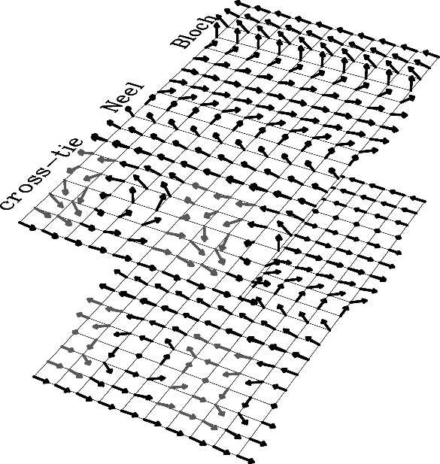
Magnetic Domain and Domain Walls
1. Domain walls
Bloch wall, Néel wall, Cross-Tie wall
The boundary between two magnetic domains in a thin film in which the magnetization vector remains parallel to the faces of the film in passing through the wall.
Cross-tie domain wall is a complex two dimensional magnetic domain wall structure, often found experimentally in thin soft ferromagnetic films with thicknesses of about several exchange lengths. The structure of such a wall can roughly be imagined as a sequence of magnetic vortices and anti-vortices, arranged along a straight line. 2. Magnetic domains
Uniaxial wall spacing , Closure domain
Stripe domains, Head to Head (Votex), Domain in
antiferromagnetic films
3. Single domain and super-paramagnetism
4. Some methods for the domain observation
SEMPA, MFM, Magneto-optical

Slide 20
The critical size below which particle exists as a single domain is given as
SW model is based on certain assumptions such as, (i) within a single domain all the spins are collinear and rotation of spins takes place coherently and collectively and (ii) interaction between the particles is negligible. In this model, the calculation were made for elongated ellipsoidal particles, because the ellipsoidal shape includes all the particle shape of physical interest, such as rod, sphere and disk.
Total anisotropy energy (alignment energy) of a particle is given as
The first term in the equation is anisotropy energy and second term is additional potential energy supplied by the field to the single domain particle

Slide 21
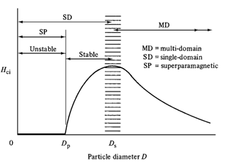
The magnetic coercivity of a magnetic nanoparticle depends significantly on their magneto-crystalline anisotropy, micro-strain, inter-particle interaction, temperature, shape and size.
In the multi domain structure, magnetization reversal occurs through a domain wall motion and the size variation coercivity is given as
At a critical size, particles become single domain where the change of direction of magnetization can occur only by coherent rotation of spins which requires high magnetic field. As an effect, it results in considerably high coercivity. Coercivity is found to be increased with the particle size within a single domain. It is because of the progressively increasing role of thermal fluctuations. Here size dependence of coercivity can be expressed as,

